Slide 1
Requirements for Dental Licensure
Educational:
Graduate from a Commission on Dental Accreditation (CODA)-accredited dental school
Written:
Complete the Integrated National Board Dental Examination (INDBE)
Clinical:
Exams on manikins and/or live patients
Exams accepted vary by state

Slide 2
Written Requirement
Integrated National Board Dental Examination (INDBE)
500 questions
2 days
Dental problem-solving tasks
https://jcnde.ada.org/inbde
Notes:
Accepted in all US states and territories fulfilling all or part of the written examination requirements for licensure
Stock image

Slide 3
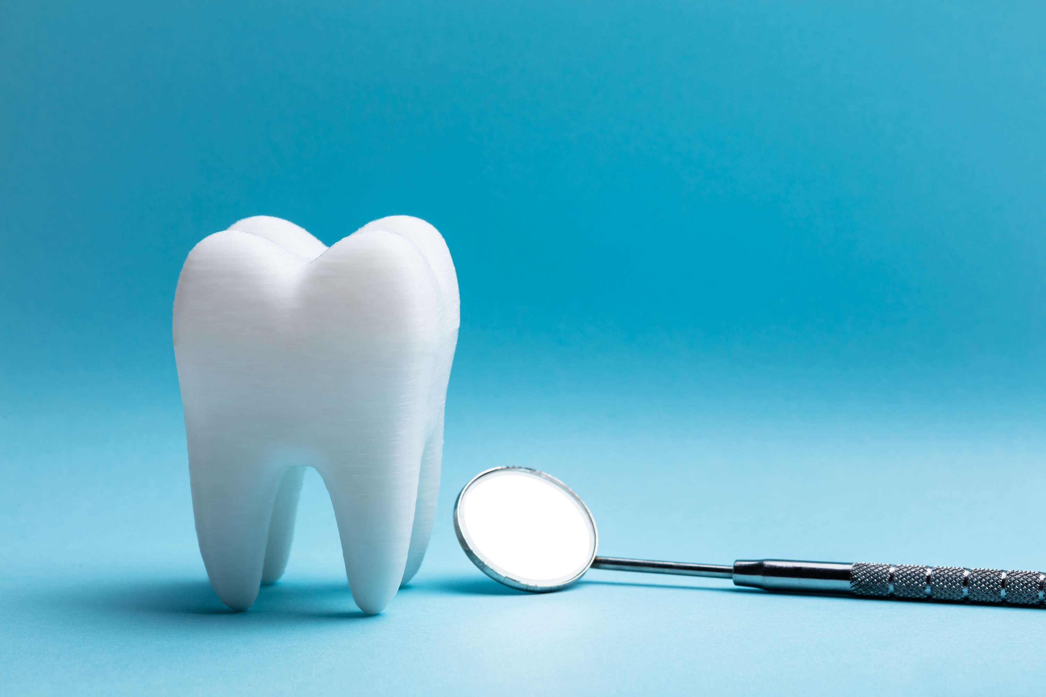
Clinical Requirement
Different Acceptances by State/Region
Manikin and/or live patient exam
3 testing agencies:
Central Regional Dental Testing Service (CRDTS)
CDCA-WREB-CITA (ADEX)
Southern Regional Testing Agency (SRTA)
Residency
Dental Licensure Objective Structued Examination (DLOSCE)
Notes:
Since the COVID-19 pandemic, many states allow manikin exams for some or all of requirements
DLOSCE: Joint Commission on Dental Examinations released DLOSCE in June 2020. Multiple questions requiring candidates to use their clinical skills to successfully complete one or more dental problem solving tasks. 6 states permit use of this, while it partially fulfills requirements in other states.
Visit state dental board websites for specific details, clarifications, updated policies
Stock image

Slide 4
Additional Resources
DentalLicensure.org map
ADEX licensure map
State dental board websites
School resources
Other state requirements: jurisprudence exam, sedation training, CPR, etc.

Slide 5
Tips and Tricks

Slide 6
What can I do now?
Action plan to become licensed:
Identify if your dental school has a prerequisite and/or deadline for INDBE and clinical examination
Investigate exam dates available. Apply for and schedule exams
Research exam preps/online bootcamps (ASDA Members get 15% discount on INDBE dental decks!)
Read candidate’s manual and state board websites VERY carefully
Understand what’s required of live patient exam if applicable
Create a study plan and schedule
Notes:
Identify if school has prerequisite classes or deadlines for INBDE and clinical examination…. May be state specific deadlines for clinical exams
Identify which clinical exam you will take.
2. Investigate exam dates available. Determine when you want to take the exam, then apply. Schedule exams.
3. Research exam preps/online bootcamps.
4. Read the candidate’s manual and state board websites VERY carefully.
5. Understand what’s required of a live patient exam if you’re not taking manikin (i.e. patient selection, insurance, travel, etc.)
6. Create a study plan. Could consider taking it during a school break.

Slide 7
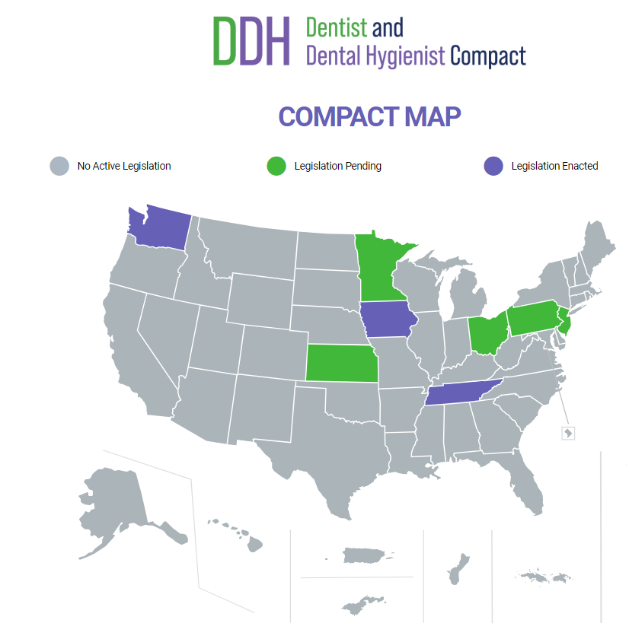
Dentist and Dental Hygienist (DDH) Compact
Creates a pathway for dentists to practice in states where they don’t hold a license
If a state wants to participate, the state legislature must vote to adopt the model language
Becomes active when 7 states adopt the model language
Learn more at ddhcompact.org
Notes:
Now going to talk about where licensure is heading.
- The work started in 2021 to begin developing this compact.
- The Council on State Governments (CSG) is the organization leading that helps states collaborate on complex public policy issues to strengthen economies, protect public health and safety, and champion state sovereignty.
- What a compact does is provides mobility and flexibility for professionals to move between states. Like how a driver’s license allows you to drive in all states, a professional compact allows you to practice in participating compact states.
- Other professions like nursing, social work, physical therapists, speech-language pathologists have compacts.
What is the Dentist and Dental Hygienist Compact?
- It’s a legally binding agreement among states. It establishes an optional, additional pathway for dentists and hygienists to practice in states where they do not hold a license. So, in order to participate, a state legislature must vote to adopt the compact language. Then, dentists in that state can participate and apply for compact privileges in other states that have adopted the legislation.
- But the state legislature needs to adopt the compact bill in order to participate.
- Participants would not need to hold a license in the other states they practice in.
- This is not a national license.
What are some benefits of the compact?
Facilitates multistate practice.
Enhances license portability when changing state of residence.
Expands employment opportunities into new markets.
Improves continuity of care when patients or providers relocate.
Expands consumer access to highly qualified practitioners.
Supports relocating military spouses.
Reduces burden of maintaining multiple licenses.
How do I apply for a compact privilege?
- Compact is not active yet. Once 7 states enact the legislation, it will become active.
- To date, legislation has been passed in 3 states: Washington, Iowa, Tennessee. Legislation is pending in: Minnesota, Kansas, Ohio, Pennsylvania and NJ.

Slide 8
Q and A

