Slide 1
ASDA Advocacy presents
Barriers to care

Slide 2
Barriers to care: what they are
Barriers to care are any sort of obstacle that limits or prevents people from receiving adequate health care, including dental care. In many cases, multiple barriers to care may be involved.
Financial hardship
Geographic location
Lack of insurance
Poor oral health literacy
Language, education or cultural barriers

Slide 3
Barriers to care: the facts
181 million American will not visit the dentist this year.
Nearly 1 in 4 (25%) of children under the age of 5 have dental caries.
Nearly 50% of Americans over the age of 30 suffer from some kind of gum disease.
As of September 30, 2022: there were 7,192 Dental Health Professional Shortage Areas (HPSA), which is an area in the US with a shortage of health care professionals. It would take 11,896 additional dental providers to meet this need (a population to practitioner ratio of 5,000:1).
Notes:
Notes:
Statistics are taken from the ADA’s Action for Dental Health: https://www.ada.org/en/public-programs/action-for-dental-health
And Kaiser Family Foundation: https://www.kff.org/other/state-indicator/dental-care-health-professional-shortage-areas-hpsas/?currentTimeframe=0&sortModel=%7B%22colId%22:%22Location%22,%22sort%22:%22asc%22%7D

Slide 4
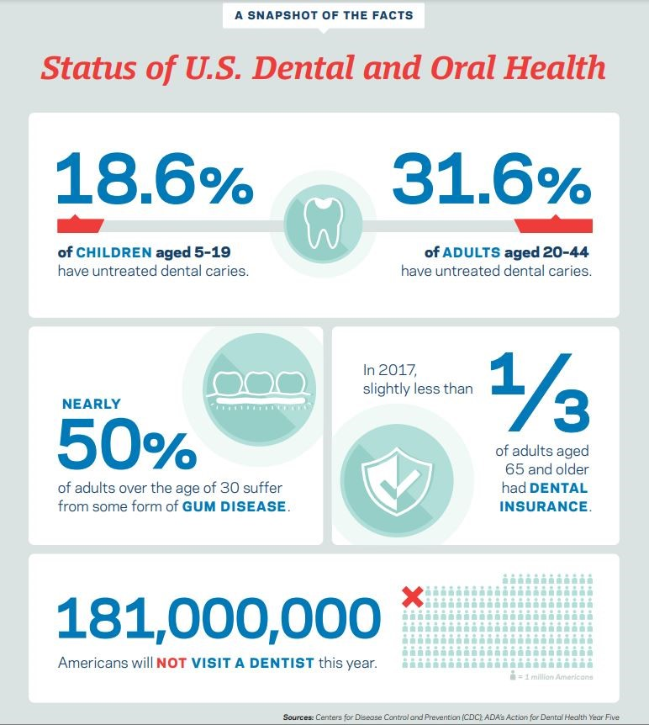
Barriers to care
Barriers to care can leave patients with serious conditions that threaten their overall health.
Notes:
As the connection between oral and systemic health strengthens, it’s important for students to understand how maintaining good oral health is crucial in maintaining overall health.

Slide 5
Barriers to care: ASDA’s stance
H-1 Student Involvement to Address Barriers to Care:
ASDA encourages the participation of interested dental students in efforts to impact the oral health of the public through projects, education, internships, externships and outreach to underserved populations.
H-2 Evidence-Based Solutions for Barriers to Care:
ASDA supports evidence-based measures that are efficacious and sustainable in reducing barriers to care in underserved communities. These measures include, but are not limited to, early intervention, Medicaid expansion and co-location of health services.
Notes:
The 2018 ASDA House of Delegates adopted these two policies. Delegates agreed dental students should be involved in the reduction of barriers to care and that evidence-based measures should be employed.
The ASDA House of Delegates previously adopted a resolution to help define the barriers to care issue. Delegates agreed that "barriers to care" be used rather than "access to care.“
In the H-2 policy, you may be wondering: What does co-location of health services mean? Co-location refers to services that are located in the same physical space (like an office, a building, or on campus), but are not necessarily fully integrated with one another. An example of this is The Giles Free Clinic, which is a Federally Qualified Health Center (FQHC) located in the Appalachian mountains of western Virginia. At this location, they co-locate primary care, behavioral health, and oral healthcare. Being under one roof enables patients to seamlessly transition from medical to dental to behavioral health services. Co-location has also helped to eliminate stigma associated with receiving certain types of healthcare like mental health, while also reducing transportation barriers. The co-location model is particularly beneficial for children who can be seen by a dentist at the time of their well-child visit.

Slide 6
Barriers to care: What else can we do?
Promote oral health education via preventative care and early intervention
Participate in efforts to impact public oral health like Medicaid expansion or Children’s Health Insurance Programs
Teledentistry
Promote evidence-based measures that are effective and sustainable like Emergency Room referral programs
Student loan forgiveness programs for working in rural or underserved areas
Initiatives and legislation that improve the oral health of those with special needs.
Engage in outreach initiatives like Give Kids a Smile and Missions of Mercy

Slide 7
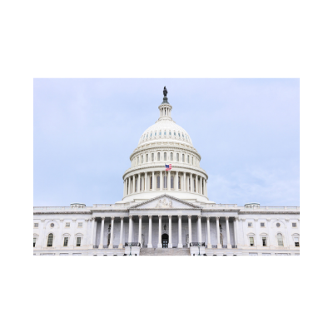
ASDA’s efforts
At ASDA and the ADA’s annual Lobby Day in 2019, 2021 and 2022 students and dentists lobbied members of Congress in support of the Ensuring Lasting Smiles Act (ELSA) in Washington, D.C.
This bill ensures children suffering from congenital anomalies and birth defects are able to receive the treatment they need.
ASDA members have sent nearly 1,000 letters to members of Congress in support of this bill.

Slide 8
ASDA’s efforts
In alignment with ASDA’s H-2 policy, ASDA continues to monitor and support legislation that expands dental Medicaid benefits at the state level.
As of April 2023, 41 states plus the District of Columbia expanded Medicaid eligibility.
Of those states, 39 states including the District of Columbia provide at least limited dental benefits for adults.
In 2022 and 2023, dental students and dentists attended the ADA Dentist and Student Lobby Day to meet with lawmakers and speak in support of The Medicaid Dental Benefit Act.
This bill would require comprehensive dental care for adults to be part of all state Medicaid programs.
In July 2022, ASDA signed onto a letter to Senate and House leaders in support of this bill.
Notes:
Stats taken from Kaiser Family Foundation: https://www.kff.org/medicaid/issue-brief/status-of-state-medicaid-expansion-decisions-interactive-map/

Slide 9
Medicaid expansion: explained
The situation
Some states cut, or don’t provide, adult dental benefits in Medicaid. This is done as a cost-saving measure.
As of April 2023, 41 states have adopted legislation to expand dental benefits through Medicaid.
These expansions often include providing low-income adults with preventative dental care.
ASDA’s response
ASDA supports evidence-based measures that are efficacious and sustainable in reducing barriers to care in underserved communities.
Increasing access to preventative dental care through Medicaid expansion can reduce overall healthcare costs by lowering emergency room visits.
Notes:
Medicaid is a joint federal and state program. Under Federal guidelines, states are not required to provide dental care. However, some states have chosen to “expand” Medicaid coverage to include dental care. This process is called Medicaid Expansion.

Slide 10
Medicaid expansion: a case study
In 2016, Missouri expanded Medicaid to include adult dental benefits.
Since then, the state has seen a dramatic reduction in dental-related emergency room visits.
In January 2015, before the benefit was in place, the state recorded 1,439 non-traumatic emergency dental department visits (based on the number of claims).
In January of 2018, 827 emergency department claims for dental visits were made, resulting in significant savings for the state.
Notes:
Read more here: https://myemail.constantcontact.com/Advocacy-Brief--Three-states-vote-to-expand-Medicaid-.html?soid=1102168765265&aid=06MUcGwIfsw

Slide 11
Emergency Room referral programs: explained
The situation
ERs are frequently utilized for non-traumatic dental conditions because patients cannot access regular dental care due to financial, geographic, insurance or other barriers
Frequently, visits are caused by tooth decay and periodontal disease that could have been avoided with routine care
ERs typically do not have the tools or diagnostic equipment necessary to evaluate and provide comprehensive care
ERs are often limited to prescribing analgesics and/or antibiotics to address the signs and symptoms, but rarely the underlying cause
These visits have severe cost implications and may contribute to longer waiting time and overcrowding of ERs
ASDA’s response
ASDA supports initiatives to set up ER referral programs. Meaning, rather than treat patients who present non-traumatic dental conditions, hospitals build connections with local dental providers who provide appropriate, comprehensive care

Slide 12
Student loan forgiveness programs: explained
The situation
The average indebted dental school graduate has about $293,900 in debt.
The Public Service Loan Forgiveness Program is a federal program that forgives borrowers’ remaining student loan balance after they make 10 years’ worth of payments while working for the government or a qualifying nonprofit organization.
ASDA’s response
ASDA supports initiatives to reduce the burden of debt for dental students by urging Congress, state legislatures and state dental associations to pass measures that include, but are not limited to:
Reducing student loan interest rates;
Providing refinancing opportunities to borrowers;
Providing opportunities for loan forgiveness, scholarships, grants and tax deductibility.
Notes:
More info on other dental school loan forgiveness programs like the following can be found here: https://www.nerdwallet.com/article/loans/student-loans/dental-school-debt-forgiveness
National Health Service Corps Loan Repayment Program
National Health Service Corps Students to Service Loan Repayment Program
Health Resources and Services Administration Faculty Loan Repayment Program
National Institutes of Health Loan Repayment Program
Indian Health Service Loan Repayment Program
Military Loan Repayment Programs

Slide 13
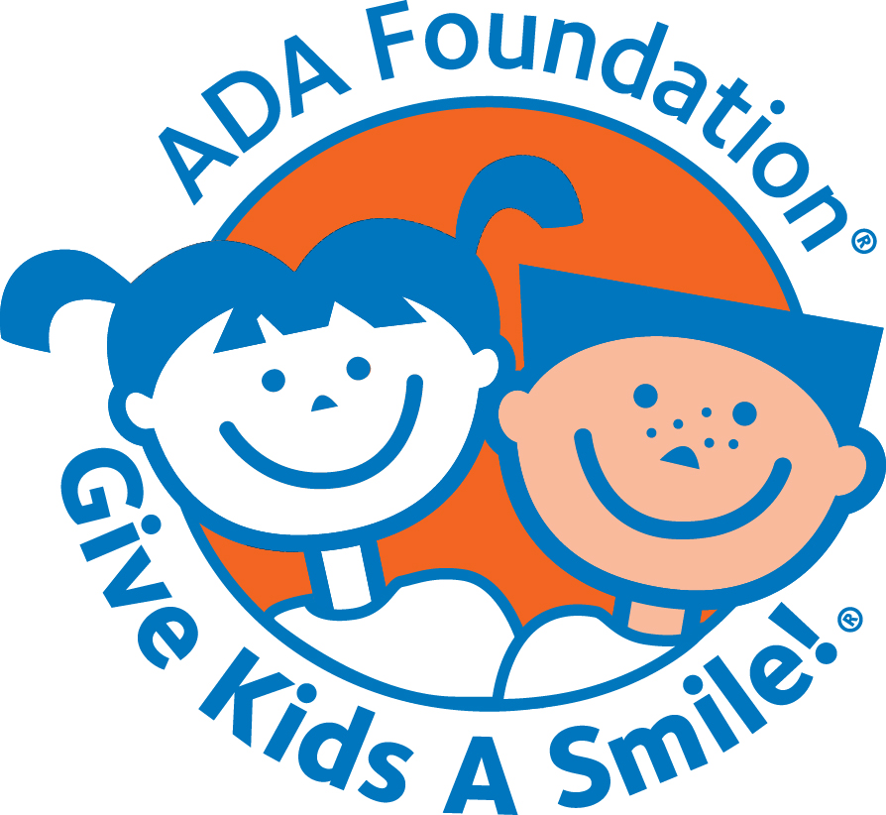
Barriers to care: what can you do?
Many chapters participate in projects like Give Kids a Smile and Missions of Mercy to provide dental care to patients who may otherwise go untreated.
Many ASDA chapters collaborate with their state associations to champion legislation that combats barriers to care.
Connect with your chapter leaders to see how you can get involved or to plan an event at your chapter.
Notes:
Photo credit :https://www.ada.org/en/public-programs/give-kids-a-smile

Slide 14
Barriers to care: get involved
ASDA Action has campaigns for legislation that combat barriers to care. Take a few minutes to write your member of Congress today!
View state and federal bills related to barriers to care on ASDA Action.
Read Advocacy Brief, ASDA’s monthly e-newsletter is devoted to legislative updates.
Attend ADA Dentist and Student Lobby Day to speak directly to the legislators that can help alleviate barriers to care.
Participate in Advocacy Month each November to champion issues like barriers to care.

Slide 15
Barriers to care: resources and organized dentistry
ADA: Oral Health and Well-Being in the United States
ADA Access to Care Webpage
AGD Access to Care White Paper
Main Barriers to Getting Needed Dental All Relate to Affordability, ADA Health Policy Institute Research Brief

Slide 16
Barriers to care: questions?

