Slide 1
ASDA Advocacy presents
Dental Student Debt

Slide 2
Dental Student Debt: the facts
The average debt per graduating senior in 2022 was $293,900, according to the American Dental Education Association (ADEA).
83% of dental students graduated with education debt in 2022.
Notes:
Notes:
Education debt is a combination of dental school debt students graduate with from dental school (the loans contracted to finance partially or all of the cost of the predoctoral degree) and predental education debt, which is the outstanding education debt students had when they entered dental school.
Statistics are taken from ADEA’s Survey of U.S. Dental School Seniors: https://www.adea.org/Seniors2022/

Slide 3
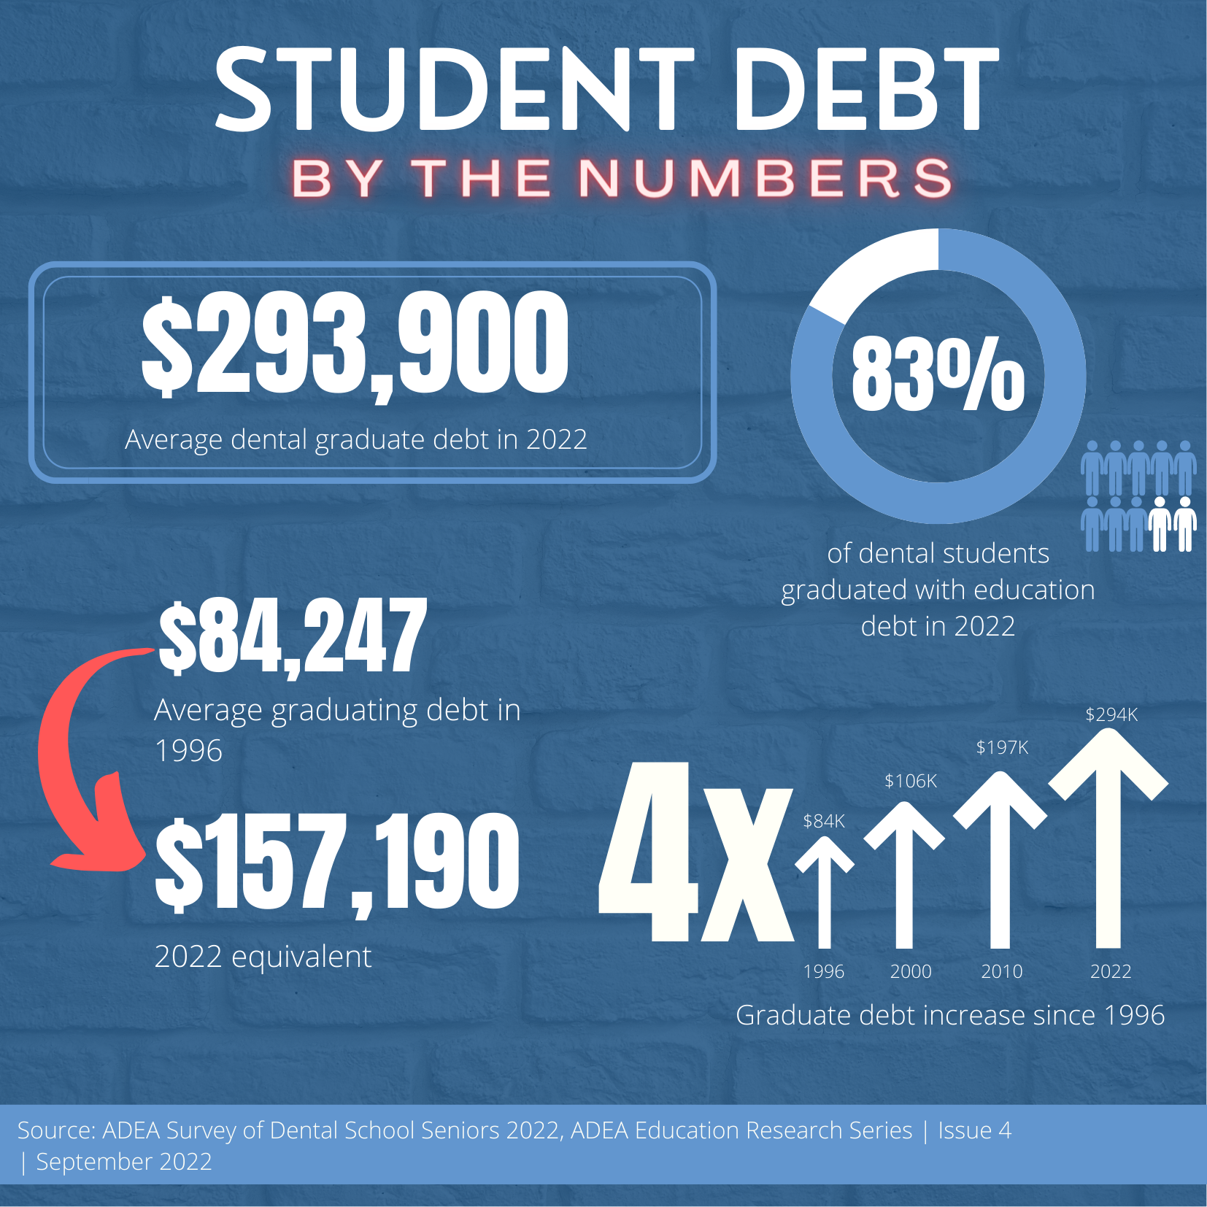
Student Debt
By the numbers
Notes:
Notes:
Average graduating debt has not kept up with inflation.
The average educational debt of a graduate in 1996 was $84,247 equivalent to $157,190 in 2022. The average debt of a dental graduate today is $293,900.

Slide 4
Dental Student Debt: how did we get here?
Shifting sources of dental school revenue.
In 1975, private and public schools received nearly 65% of their total revenue from federal and state funds. Tuition accounted for less than 17%.
In 2020, state and local funding for private and public dental schools dropped to 10%. Federal funding dropped to 0.2%. Tuition and fees accounted for more than 45%.
Decline in higher education funding from:
Federal government
State and local funding
Education institutions
Notes:
Source: American Dental Association, Health Policy Institute, 2020-21 Survey of Dental Education (Group III).

Slide 5
Dental Student Debt: how did we get here?
Year | Tuition and Fees Revenue in $ | % of Total Revenue
2010 | $952,298,799 | 31.4%
2020 | $1,906,079,132 | 45.3%
Year | State and Local Support Revenue in $ | % of Total Revenue
2010 | $422,823,992 | 14%
2020 | $438,007,984 | 10.6%
Notes:
Source: American Dental Association, Health Policy Institute, 2020-21 Survey of Dental Education (Group III).
Notes:
In 2010, tuition and fees accounted for 31.4% of dental school revenue. State and local funds accounted for 14% of revenue. In 2020, tuition and fees accounted for 45.3% of dental school revenue. State and local funds accounted for 10.6% of revenue.
Although the dollar amount of state and local funding increased from 2010 to 2020, state and local funds represented only 10.6% of dental school revenue in 2020, a 3.4% decrease from 2010.

Slide 6
Dental Student Debt: why does it matter?
The average debt of graduating dental students has significantly increased in the last 20 years.
Educational debt factors into dentists' career decisions after graduation.
A High level of debt can jeopardize a new dentist’s ability to choose their preferred career path.
Dental students with high levels of debt have reported stress and concern about paying off their loans.
Notes:
Sources:
ADEA Survey of Dental School Seniors 2019
Boyles, J., Ahmed, B. Does student debt affect dental students' and dentists' stress levels?. Br Dent J 223, 601–606 (2017). https://doi.org/10.1038/sj.bdj.2017.876

Slide 7
Dental Student Debt: Impact on career choices
ADEA’s 2019 Survey of Dental School Seniors asked students to rank what influenced them to choose their professional path after graduating.
75.9% of respondents ranked level of educational debt either first or second.
This ranked above location, degree of autonomy in work, and job security.
Notes:
Source:
ADEA Survey of Dental School Seniors 2019

Slide 8
Dental Student Debt: ASDA’s stance
F-4 Dental Education Financing:
ASDA supports initiatives to reduce the burden of debt for dental students. The association urges Congress, state legislatures and state dental associations to pass measures that include, but are not limited to:
Reducing student loan interest rates;
Providing refinancing opportunities to borrowers;
Providing opportunities for loan forgiveness, scholarships, grants and tax deductibility.
Notes:
Notes:
ASDA considers the growing student debt crisis a top priority and advocates for financially sustainable, long-term solutions.

Slide 9
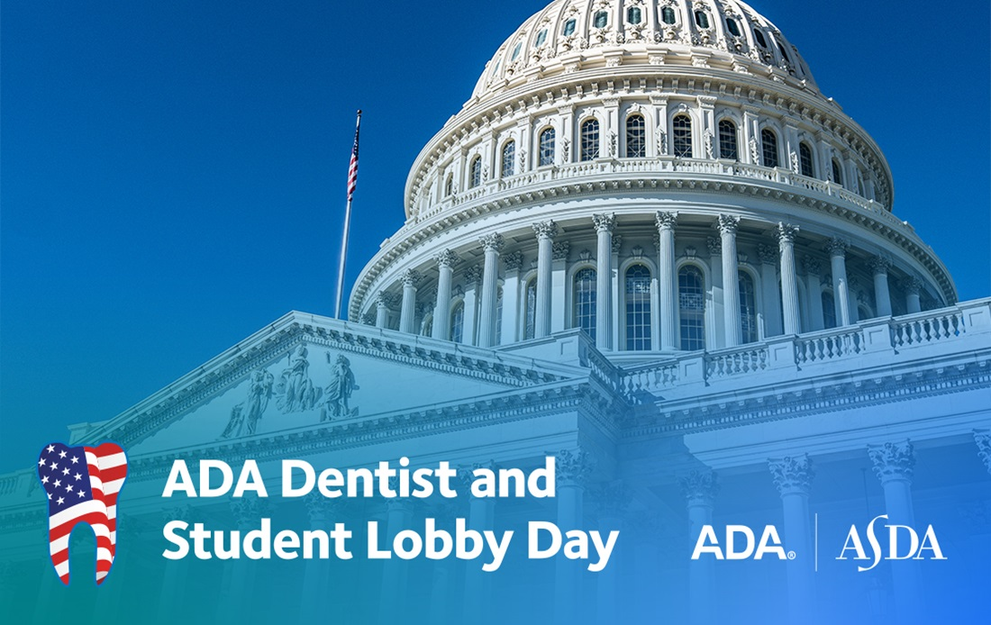
ASDA’s efforts
Students and dentists have lobbied members of Congress in support of several bills pertaining to student loans at ASDA and the ADA’s annual Lobby Day in Washington, D.C.
The Resident Education Deferred Interest (REDI) Act
This legislation would allow medical and dental residents to defer their student loans, interest-free, during residency.
ASDA lobbied for this bill at Lobby Day in 2021, 2022 and 2023
ASDA has signed onto several coalition letters and has been listed as a supporting organization for the REDI Act many times.
Notes:
Notes:
The REDI Act could save dental student thousands of dollars in the long-run.
The REDI Act does not provide any loan forgiveness or reduce a borrower’s original loan balance. The main goal is to prevent dentists and physicians “from being penalized during residency by precluding the government from charging them interest on their loans during a time when they are unable to afford payments on the principal,” https://www.ada.org/publications/ada-news/2023/march/coalition-supports-resident-education-deferred-interest-act
You can show your support for the REDI Act by sending a letter to your legislator via ASDA Action: https://www.asdanet.org/ASDAaction?vvsrc=%2fcampaigns%2f87000%2frespond
Photo source: https://www.ada.org/advocacy/advocacy-dentist-and-student-lobby-day

Slide 10
ASDA’s efforts
Student Loan Refinancing Act
This legislation would allow borrowers to refinance federal student loans more than once, so they can take advantage of lower interest rates.
ASDA lobbied for this bill at Lobby Day in 2021 and 2022
Student Loan Refinancing and Recalculation Act
This bill directs the Department of Education (ED) to establish a program to refinance the outstanding principal, interest, and late charges on federal student loans. It would allow borrowers in dental internships or residency programs to defer student loan payments until the completion of their programs.
ASDA lobbied for this bill at Lobby Day in 2021

Slide 11
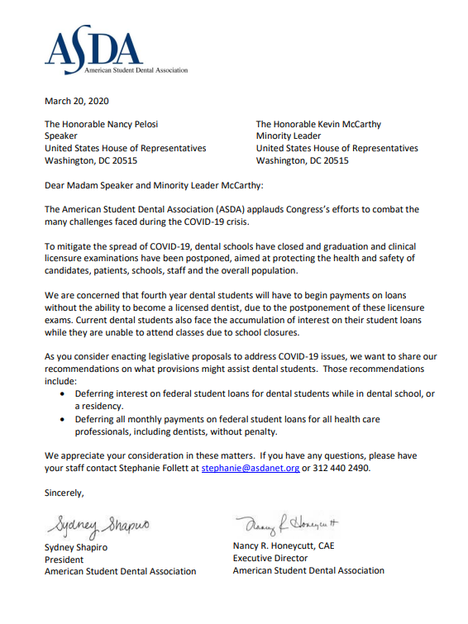
ASDA’s efforts: COVID-19
At the beginning of the COVID-19 pandemic in 2020, ASDA members came together and successfully lobbied to defer all monthly payments and interest accrual on federal student loans.
Throughout the course of the pandemic, the cutoff date for ending these flexibilities was extended multiple times.

Slide 12
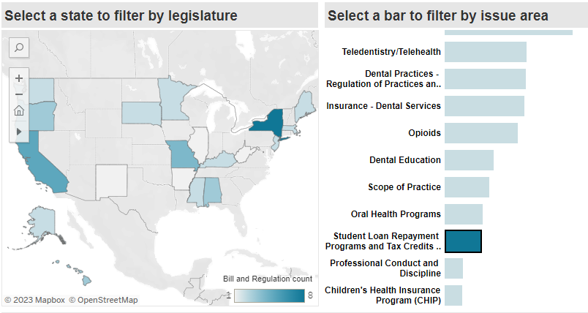
Dental Student Debt: Stay informed
ADEA’s interactive tracking map provides current information on state legislation and regulations of interest to academic dentistry. To stay informed on issues pertaining to student debt in your state, just click:
Student Loan Repayment Programs and Tax credits or
Higher Education Funding

Slide 13
Dental Student Debt: Loan forgiveness and repayment programs
There are a variety of loan repayment and forgiveness programs available to alleviate the burden of dental student loans. Options include:
Federal- and State-based programs
Public Service Loan Forgiveness (PSLF)
National Health Service Corps Loan Repayment Program
Indian Health Service Loan Repayment Program
Private programs
Eligibility will vary depending on the program.
Notes:
Sources:
Indian Health Service: https://www.ihs.gov/loanrepayment/
National Health Service Corps https://nhsc.hrsa.gov/loan-repayment/nhsc-loan-repayment-program
Federal Student Aid: https://studentaid.gov/
PSLF: https://studentaid.gov/manage-loans/forgiveness-cancellation/public-service

Slide 14
Dental Student Debt: Loan forgiveness and repayment programs
To be eligible for Public Service Loan Forgiveness (PSLF), you must:
Work full time for a government or non-profit organization
Make 120 qualifying payments on your loan (this equates to 10 years of payments)
State-based Loan Forgiveness:
Most states have their own student loan repayment programs that are available to dentists.
Requirements and eligibility will vary by state.
ADEA maintains a list of state-based forgiveness programs
Notes:
Sources:
Public Service Loan Forgiveness: https://studentaid.gov/manage-loans/forgiveness-cancellation/public-service
ADEA: https://www.adea.org/advocacy/state/loan-forgiveness-programs.aspx

Slide 15
Dental Student Debt: Loan forgiveness and repayment programs
National Health Service Corps (NHSC) Loan Repayment Program:
Participants must agree to a two-year service contract working full time or part time in a Health Professional Shortage Area (HPSA).
Part-time providers are eligible for a maximum of $25,000 of repayment assistance,
Full-time employees are eligible for a maximum of $50,000 of assistance.
Income-Driven Repayment (IDR):
IDR is a federal program that can offer a lower monthly payment on federal student loans
Monthly payments are determined based on income and family size.
Notes:
Sources:
National Health Service Corps Loan Repayment Program: https://nhsc.hrsa.gov/loan-repayment/nhsc-loan-repayment-program
Income-Driven Repayment: https://studentaid.gov/idr/
Image Source: https://data.hrsa.gov/maps/map-gallery

Slide 16
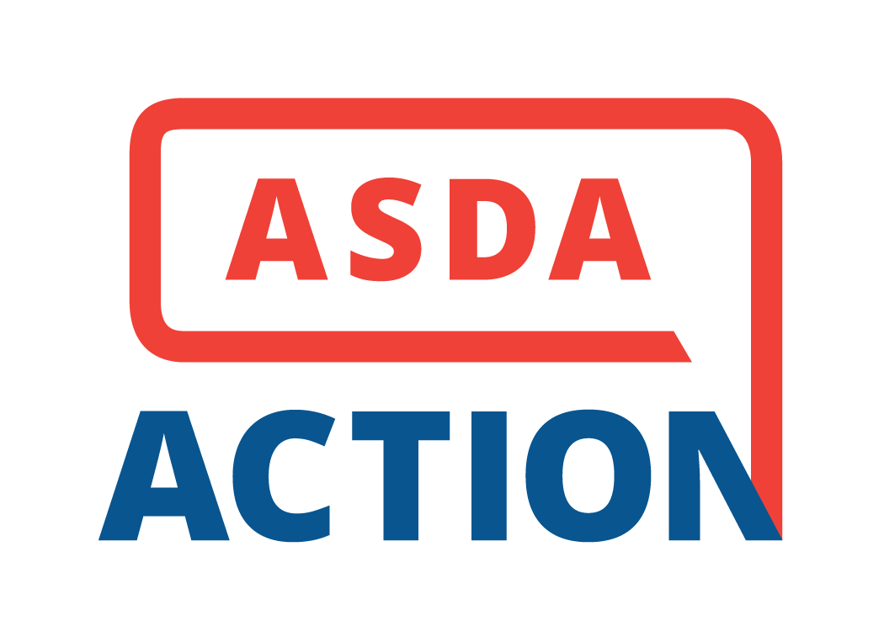
Get Involved
Sign up for ASDA Action texts to receive alerts and stay updated on ASDA’s advocacy initiatives.
ASDA Action has campaigns for legislation that address the student debt crisis. Take a few minutes to write your member of Congress today!
Read Advocacy Brief, ASDA’s monthly e-newsletter is devoted to legislative updates.
Attend ADA Dentist and Student Lobby Day to speak directly to the legislators that can help alleviate the debt crisis.
Participate in Advocacy Month each November to champion issues like dental student debt.

Slide 17
Dental Student Debt: In summary
Dental student debt has increased over time.
Educational debt impacts the career choices and wellbeing of future dentists.
ASDA supports initiatives to reduce the burden of debt for dental students.
There are various loan forgiveness and repayment programs available to dental professionals.

Slide 18
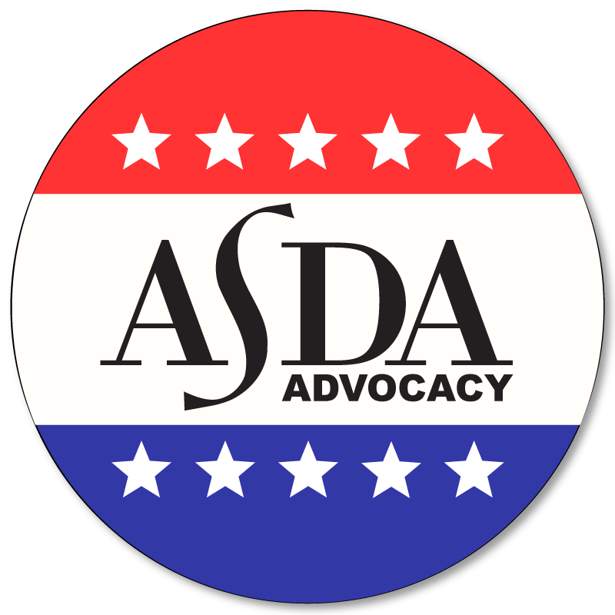
Resources
Visit ASDA’s Scholarships page
ADEA’s summary of state student loan repayment programs
ADEA Data, Analysis and Research: Dental School Seniors

Slide 19
Questions?

