Slide 1
ASDA Action 101
SPEAKER NAME, CHAPTER
Notes:
USE THIS SLIDE AS YOUR OPENING SCREEN.

Slide 2
What is ASDA Action?
ASDA Action is ASDA’s grassroots advocacy software.
Joining ASDA Action is the most efficient way to stay informed on critical issues that impact dental students and the dental profession.
With ASDA Action you can:
Contact your legislator with a letter and ask them to co-sponsor a bill.
Look up any state or federal bill that impacts dental students or the dental profession.
View bills that ASDA supports, monitors, or opposes.
Sign up for text alerts to stay on top of ASDA advocacy efforts.

Slide 3
What is ASDA Action?
ASDA Action also has election tools that allow you to:
Look up who your elected officials are.
Look up your candidates running for office.
Register to vote.
Find you polling location.

Slide 4
Why sign up for ASDA Action?
ASDA Action allows you to participate in the discussion and legislative process that impacts your life as a dental student and future dentist.
The software makes it easy to connect with legislators on the issues that matter to you.
ASDA Action’s text alert system will keep you informed on critical issues.
Your advocacy efforts will earn you points in the Advocacy Certificate Program when you sign up for text alerts or send a letter to your legislator.

Slide 5
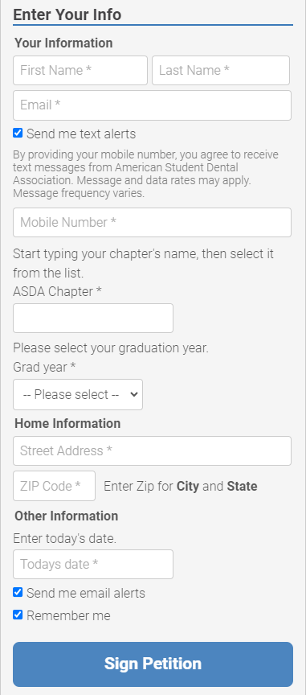
How do I sign up?
To join ASDA Action:
Go to asdanet.org/asdaaction
Select the Sign up for Alerts button at the top of the homepage.
Fill out the petition on the right-hand side of the page.
Notes:
To join, you will need to provide your name, email, chapter, grad year, home address and the date you signed up. You have the option to sign up for text alerts by selecting the Send me text alerts checkbox and providing your mobile number.

Slide 6
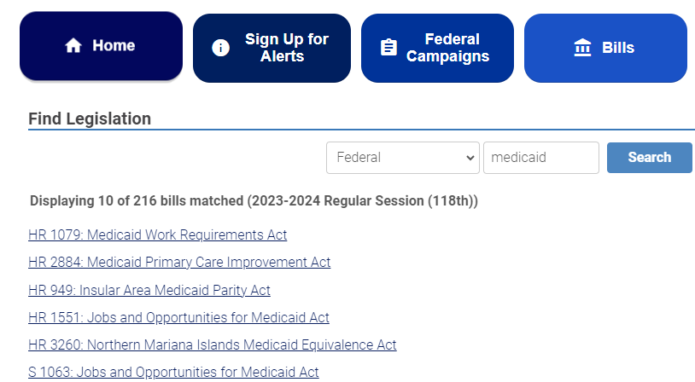
Navigating ASDA Action: Search for a bill
To search for current federal and state bills:
Click the Bills tab on the ASDA Action Homepage
Search for a bill using the search bar under Find Legislation.
The dropdown menu allows you to search by state.
You can also view key legislation by category on the Bills page.
Notes:
Example:
Go to the Bills page and search “Medicaid” under federal bills.
Note: You can view past legislation on ASDA’s Legislation and Letter Archive: https://www.asdanet.org/index/get-involved/advocate/legislation-and-letter-archive

Slide 7
Navigating ASDA Action: Send a letter
To send a letter on key legislation
Click the Federal Campaigns tab on the ASDA Action Homepage.
Select the legislation you would like to contact your official about.
Compose your message using the tool on the right-hand side of the page.
ASDA Action provides a pre-written letter, but you can choose to write your own message.
ASDA Action will automatically address the letter to your local officials based on your home address.
The letter composition tool pre-populates your contact information.
Notes:
Example of composed letter on next slide.

Slide 8
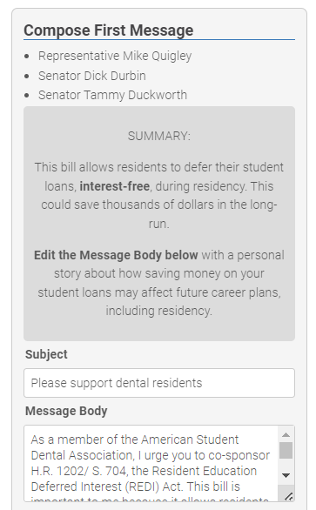
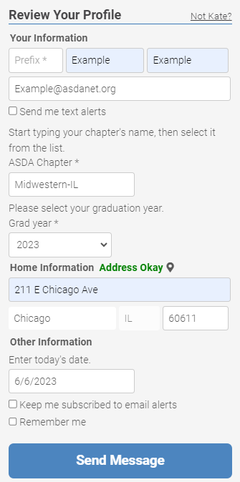
Notes:
This information will appear automatically once you create a profile.

Slide 9
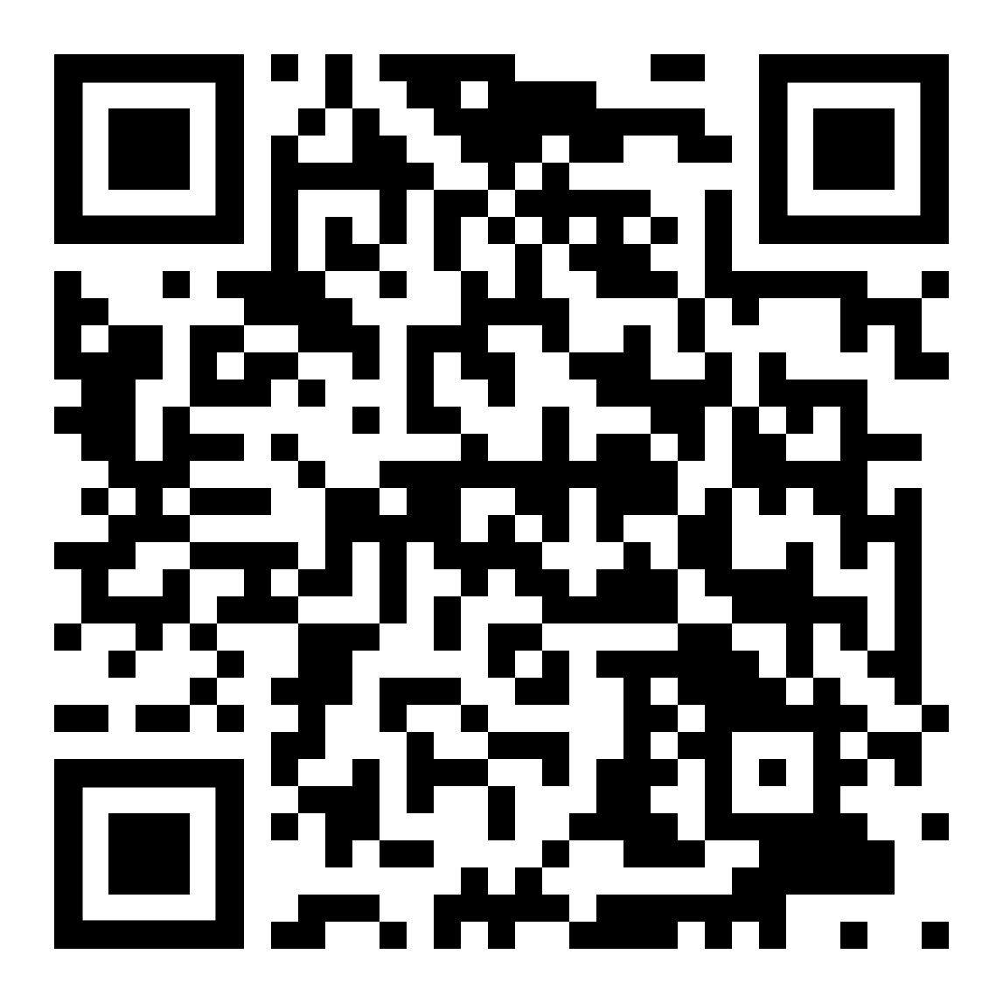
Sign up today!
Whether you are new to advocacy or looking for a way to expand your current efforts, ASDA Action is a fast and effective way to stay informed and take action!

Slide 10
Thank you!

