Slide 1
National Governing and Leadership Structure

Slide 2
What is ASDA?
The American Student Dental Association is a national student-run organization that protects and advances the rights, interests and welfare of dental students.
It introduces students to lifelong involvement in organized dentistry and provides services, information, education, representation and advocacy.
Notes:
2

Slide 3
Why Does ASDA’s Structure Matter to Leaders?
Provides the framework to carry out business of the association.
Shows leaders where to go for information.
Helps leaders become experts on all things ASDA and pursue their leadership path.

Slide 4
ASDA’s Governing Structure
ASDA House of Delegates
140 Delegates: two representatives from each of the 70 U.S. dental school
ASDA Board of Trustees
Executive Committee
President
Two vice presidents
Executive director
Speaker of the house
Immediate past president
Eleven district trustees
Standing Committees
Editorial Board
Membership
Professional Issues
Communications
Advocacy
Board Management Committees
Governance Committee
Committee on Sessions
Notes:
4

Slide 5
Executive Committee
Oversees and administers the work of ASDA between Board of Trustees meetings
Fulfills the directives of the house of delegates
Reviews the budget and oversees fiscal planning
Approves interim policy and procedures
Who makes up the Executive Committee?
President
Two vice presidents
Speaker of the house
Executive director
Elected by the ASDA house of delegates
Notes:
5

Slide 6
Board of Trustees
Oversees and administers the work of ASDA
Fulfills directives of the House of Delegates
Approves the budget
Assigns work to ASDA’s councils and committees
Appoints leaders
Determines interim policy by 2/3 vote between House meetings
Who is the Board of Trustees, and how are they in position?
Executive Committee: Elected by the House of Delegates
Immediate Past President: Assumes role after presidential year
District Trustees: Each trustee is elected by their individual (one of 11) districts
Notes:
6

Slide 7
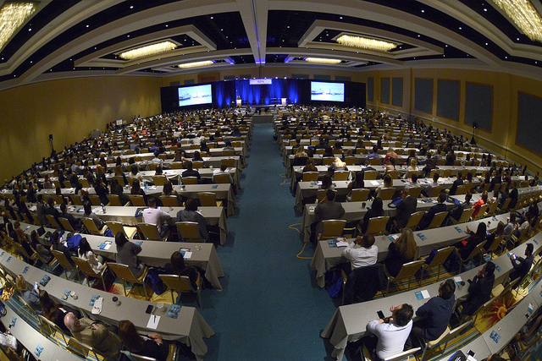
Who is ASDA’s House of Delegates?
140 Voting Delegates:
Two delegates from each of ASDA’s 70 chapters get to vote.
Speaker of the House (non-voting)
Board of Trustees (non-voting)
Council chairs (non-voting)
Secretary (ASDA’s Executive Director, non-voting)
Notes:
7

Slide 8
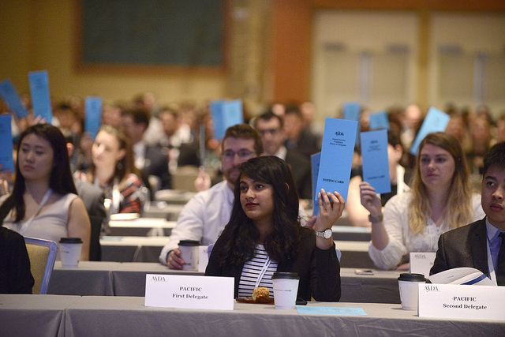
Role of the House of Delegates
Supreme legislative body of ASDA
Elects officers (Executive Committee)
Determines the policies governing ASDA
Amends Bylaws and Standing Rules of the House of Delegates
Notes:
8

Slide 9
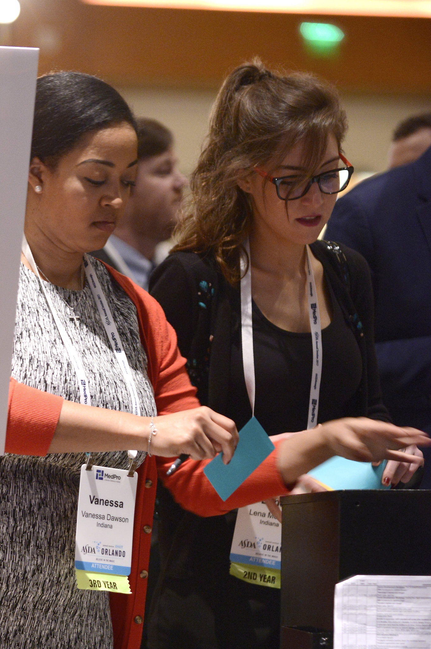
Elections at Annual Session
House of delegates votes on:
Executive Committee
Districts elect their trustees
Notes:
9

Slide 10
Standing Committees
Undertake long-term assignments and carry out the work of the house of delegates and Board of Trustees.
Members are appointed by the Board of Trustees.
ASDA currently has the following standing committees:
Council on Advocacy
Council on Communications
Council on Membership
Council on Professional Issues
Editorial Board
Notes:
10

Slide 11
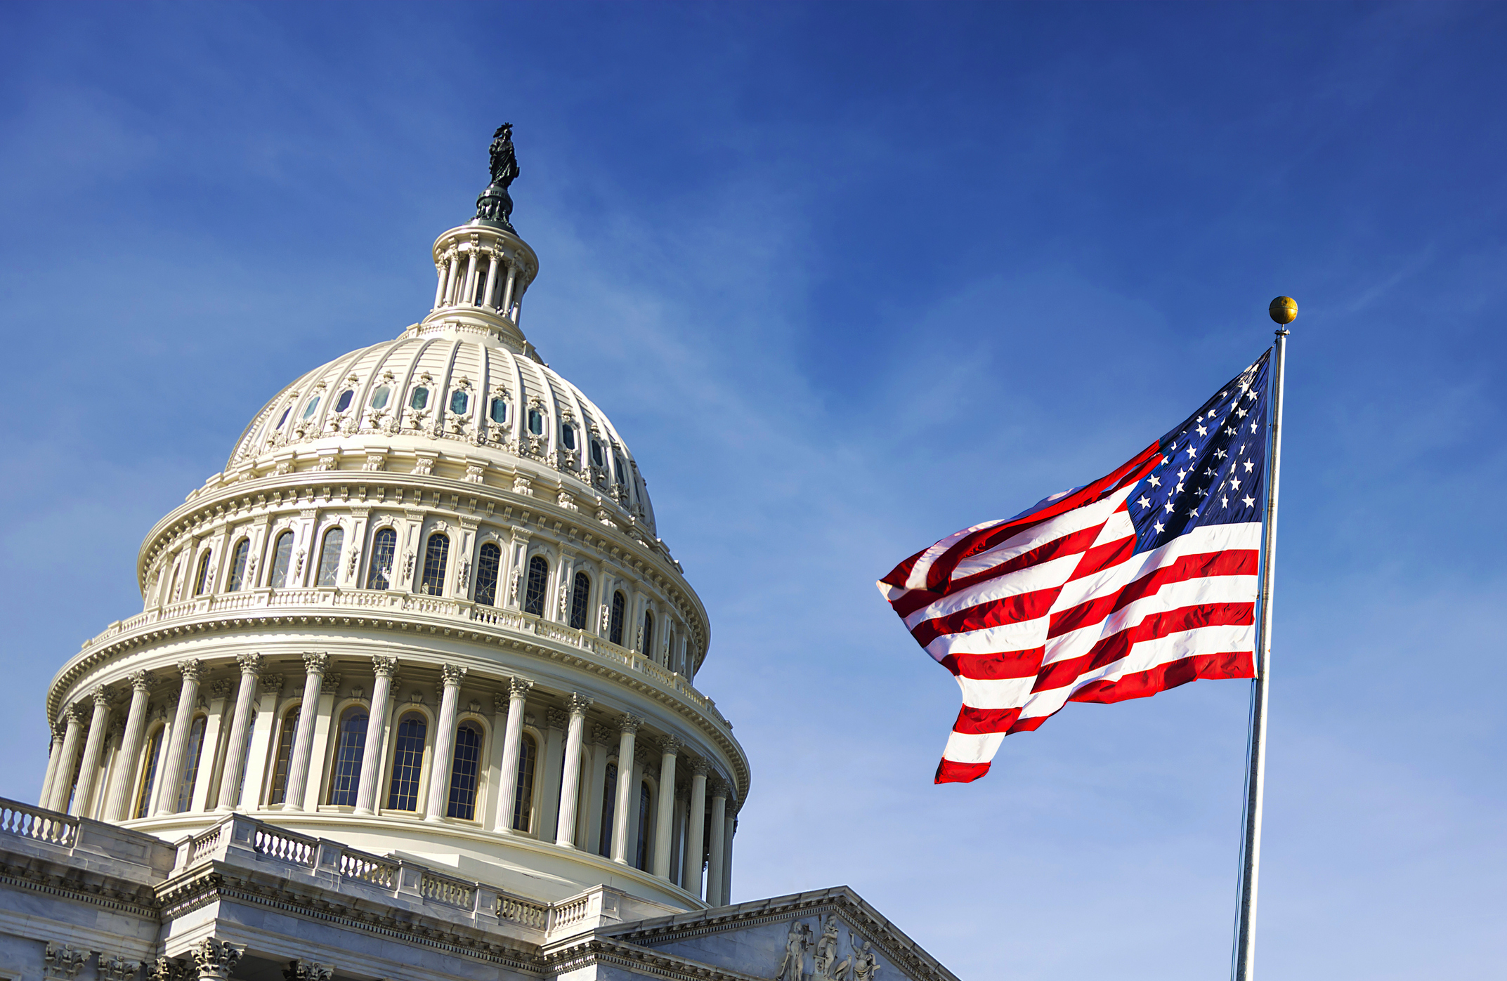
Council on Advocacy
Members include:
Chair
Five Legislative Coordinators based on region
One Executive Committee member
Two Board of Trustees liaisons
Represents the interests of dental students on legislative and regulatory issues that impact the dental profession. The council launches grassroots initiatives to promote action-oriented advocacy in support of dental students and the patients they serve.

Slide 12
Council on Communications
Members include:
Chair
Two associates
Two video production managers
Board of Trustees liaison
Responsible for creating videos to disseminate information via various media channels to promote various national ASDA initiatives, including but not limited to: webinars, advocacy initiatives, wellness initiatives, membership information, national grants and awards, national meetings, etc. The council acts as a resource for and promotes chapter communication efforts.

Slide 13
Council on Membership
Members include:
Chair
Two associates
One AS/IDP associate
Two Board of Trustees liaisons
Assesses and develops resources that meet the needs of ASDA’s members and chapters. The council assists chapters and trustees with membership initiatives.

Slide 14
Council on Professional Issues
Members include:
Chair
Two associates
Two Board of Trustees liaisons
Serves the association as a resource on community engagement, dental outreach and other pandemic/epidemic implications that may arise. Additionally, the council is committed to promoting diversity, equity, and inclusion initiatives among dental students.

Slide 15
Editorial Board
Members include:
Editor-in-Chief
Six contributing editors
Works closely with staff to determine the strategy and themes for ASDA’s print publication, Contour.
Notes:
15

Slide 16
Management Committees
The Board of Trustees may appoint management committees to address initiatives that fall outside the duties of the Board but require Board knowledge or expertise.
Appointed by the Executive Committee.
ASDA currently has two management committees:
Governance Committee
Committee on Sessions

Slide 17
Committee on Sessions
Members include:
Chair
Immediate Past President
Two Board of Trustees liaisons
Responsible for the planning of the upcoming Annual Session. The committee maintains the importance of governance and policy associated with the Annual Session.

Slide 18
Governance Committee
Members include:
Chair
Speaker of the House
Two Board of Trustees liaisons
Reviews the ASDA governance documents and proposes changes as to keep documents current. The committee ensures that all ASDA documents are consistent with the governing documents.

Slide 19
ASDA staff
Manage the day-to-day operations
Serve members and support leaders
Serve as liaisons to standing committees and board management committees

